Slide 1
Section 2.8: Weighted Voting Systems
Math for Liberal Studies

Slide 2
Unequal Voters
In many voting systems, the voters are not treated equally
Juries: If one voter votes “not guilty,” then the result is “not guilty”
Stockholders: If you have more shares of stock, then your vote is weighted more heavily
US Electoral College: Larger states get more votes
European Union: Larger member countries get more votes

Slide 3
Groups of Voters
In most governments around the world, different parties are represented in a legislature
Most often, members of these parties vote the same way
We can think of each party as being a single voter; the more seats that party has, the more power it wields

Slide 4
Weighted Voting Systems
The weight of each voter is the number of “points” their vote is worth
For example, in the 2008 Electoral College, Pennsylvania was worth 21
When Barack Obama won Pennsylvania, we could consider the entire state as a single voter worth 21 points that cast its vote for him

Slide 5
Weighted Voting Systems
These systems are most often found in legislatures or other governing bodies
Votes in these bodies are “for” or “against” bills and amendments
To simplify things, we will assume that every voter in a weighted voting system is voting “yes” or “no”

Slide 6
Weighted Voting Systems
The number of votes necessary for a motion (bill, amendment, etc.) to win is called the quota
For example, in the US Congress, a 2/3 majority in each house is required to override a Presidential veto
There are 435 votes in the House of Representatives, so 290 votes would be the quota
In the Senate there are 100 votes, so 67 votes is the quota

Slide 7
Another Quota Example
In the US Senate, 60 votes are required to stop debate and force a vote on a bill
If 60 votes are not available, Senators can filibuster (debate endlessly), essentially killing the bill
So the quota to stop a filibuster is 60, instead of a simple majority (51)
This is why it was big news in 2009 when the Democrats had 60 Senators

Slide 8
The Electoral College
In US Presidential elections, plurality elections are held in each state
The candidate winning each state sends electors to vote for him or her in the Electoral College
The number of electors per state depends on the size of the state: bigger states have more electors

Slide 9
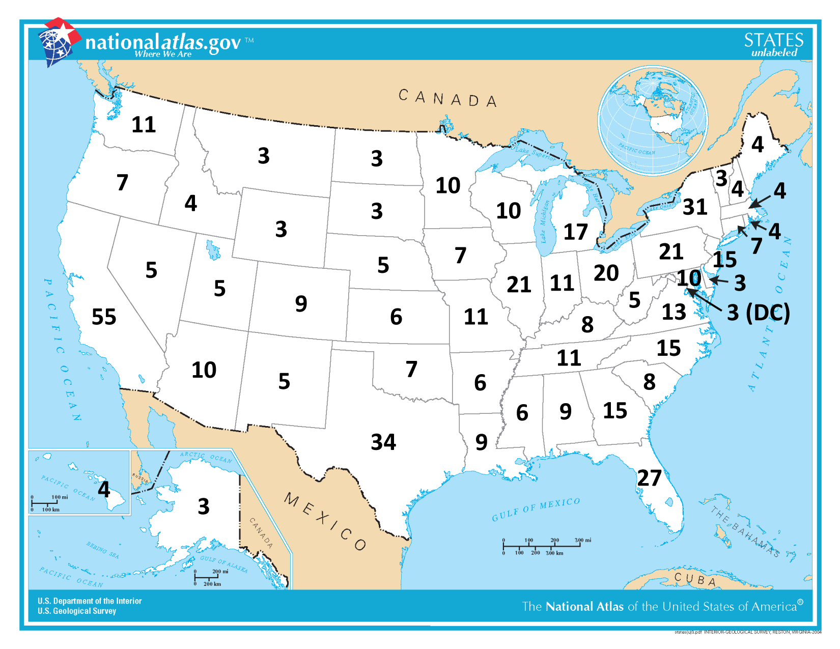
2008 Electoral Map

Slide 10
Notation
When we talk about weighted voting systems, we use a compact notation to list the quota together with the various weights
[q: a, b, c, …]
q is the quota
a, b, c, etc. are the weights
So the electoral college system would be written [270: 55, 34, 31, 27, 21, 21, etc.]

Slide 11
An Example: [20: 15, 10, 5]
In this voting system, there are three voters, which we’ll call X, Y, and Z
The quota is 20, so none of the voters can pass a bill by themselves
The voters need to work together and form coalitions to get something to pass

Slide 12
Coalitions
X and Z might decide to work together
We write this as {X, Z}
This coalition has 20 combined votes, which is enough to win
We call this a winning coalition

Slide 13
Coalitions
Y and Z might decide to work together
This coalition has 15 combined votes, which is not enough to win
However, if everyone in this coalition votes “no,” then there aren’t enough votes left to get a motion to pass
We call this a blocking coalition

Slide 14
Coalitions
A winning coalition is a collection of voters that can pass a motion by all voting “yes,” even if every other voter votes “no”
A blocking coalition is a collection of voters that can prevent a motion from passing by all voting “no,” even if every other voter votes “yes”

Slide 15
Coalitions
How many votes does a coalition need to be a blocking coalition?
Enough so that all the other voters combined cannot win
If the total number of votes is $T$ and the quota is $Q$, then the coalition needs $T−Q+1$ to be a blocking coalition

Slide 16
Special Voters: Dictators
A dictator is a voter that is a winning coalition by itself
[51: 60, 40]
In this system, the weight-60 voter is a dictator
[20: 15, 10, 5]
In this system, none of the voters is a dictator

Slide 17
Special Voters: Dummy Voters
A dummy voter is a voter whose vote does not matter. When voters form a winning coalition with a dummy voter, it can be “safely” removed from the coalition without changing the result
[51: 26, 26, 26, 22]
Any winning coalition that includes the weight-22 voter can safely remove it and still win

Slide 18
Special Voters: Dummy Voters
If a voter is a member of a winning coalition, but when that voter is removed, the coalition is no longer winning, then that voter was critical to the coalition

Slide 19
Special Voters: Dummy Voters
For example, in the system [20: 15, 10, 5], the coalition {A, B} is a winning coalition
If we remove A, all we have left is {B}, which is no longer winning; so A was critical
Similarly B is critical to this coalition, since if we remove B, all we have left is {A}, which is no longer winning

Slide 20
Special Voters: Dummy Voters
In the system [20: 15, 10, 5], the coalition {A, B, C} is also a winning coalition, but this time only A is critical
A dummy voter is a voter that is never a critical voter in a winning coalition

Slide 21
Special Voters: Veto Power
A voter has veto power if it is a blocking coalition by itself
[21: 20, 15, 5]
The voter with weight 20 has veto power: if that voter votes “no,” then the motion cannot pass
Jury: [12: 1, 1, 1, 1, 1, 1, 1, 1, 1, 1, 1, 1]
Since all 12 voters must vote in favor to pass the motion, each voter has veto power

Slide 22
More Examples
[8: 5, 3, 1]
None of the voters is a dictator
The weight-1 voter is a dummy voter
The weight-5 and weight-3 voters have veto power
[9: 5, 3, 1]
Motions can only pass unanimously: none of the voters is a dictator, there are no dummies, and all of the voters have veto power

Slide 23
More Examples
[6: 5, 3, 1]
None of the voters is a dictator
None of the voters is a dummy
The weight-5 voter has veto power
[51: 49, 48, 3]
None of the voters is a dictator
None of the voters is a dummy
None of the voters has veto power

Slide 24
Looking Closer
Consider the system [51: 49, 48, 3]
Even though the third participant only has a weight of 3, it has the same “power” as the other two
Any two of the three participants can combine to pass a motion, and none of the three can pass a motion alone

Slide 25
Looking Closer
In the system [51: 26, 26, 26, 22], the fourth participant has almost as much weight as the other three, but is a dummy voter
Dummies have no power to influence elections one way or the other

Slide 26
Measuring Power
We have seen that the power a voter wields is not necessarily directly related to the weight of the voter
We will want to measure the power of each voter, keeping in mind that:
dictators have all the power; when one voter is a dictator, all other voters are dummies
dummies have zero power

